Slide 1
How to pull the ESR

Slide 2
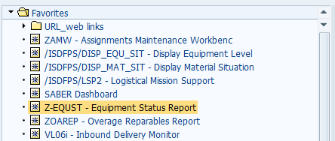
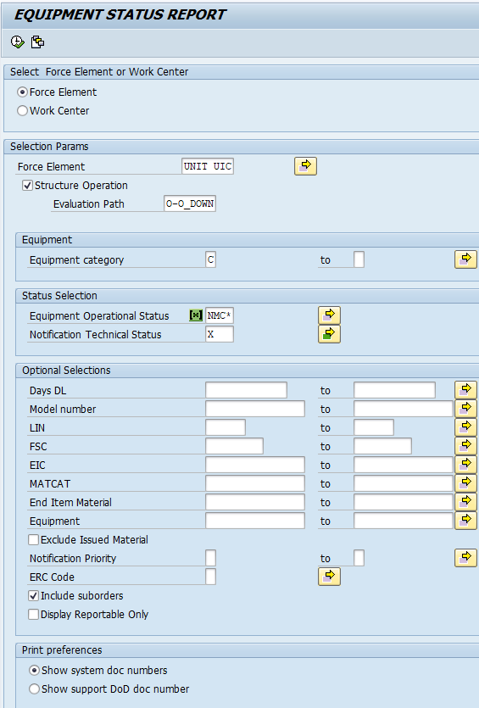
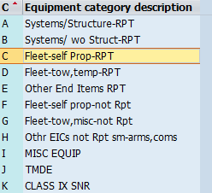
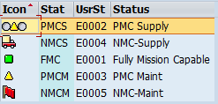
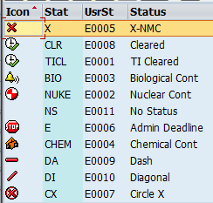
1st screen, water screen
2nd screen, Equipment Status Report
2
1
2
3
3
NOTE: Step 3& 4 - Default set already, keep as is unless you need other equipment info.
4
4

Slide 3
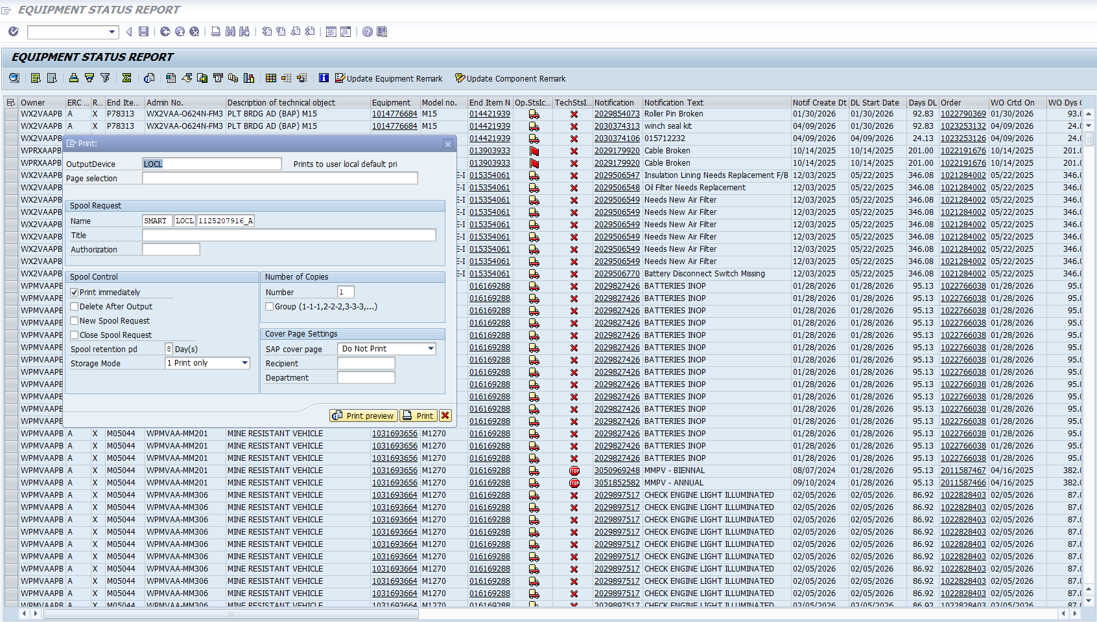
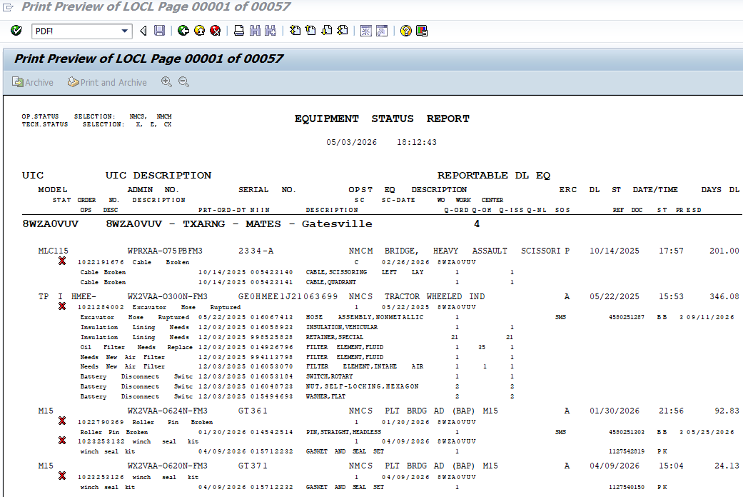
1
3
4
2

Slide 4
